Slide 1
What Works with PSC & Drug Courts
Prof. M. H-Evans
Reims University

Slide 2
10 main or key components
Bureau of Justice Assistance, Defining the Drug Courts. The Key Components (1997) + other studies
Judicial supervision by a fair, caring, and respectful judge
Public and Fair Hearings
Specialisation
Problem-Solving
Swift Intermediary Sanctions + Rewards
Collaborative and Interagency work
Community-Based Justice
One-Stop Shop
Frequent Drug Testing
Desistance Rituals

Slide 3
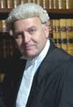
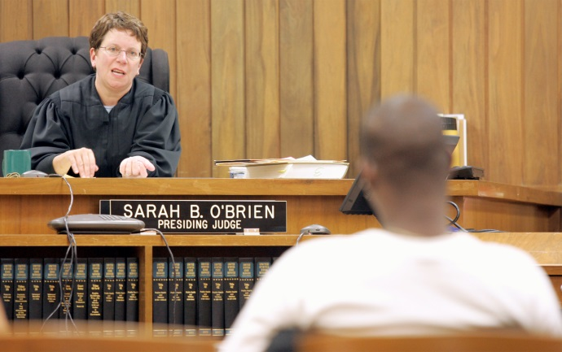
1-Judicial Supervision
I have already explained why Judicial Supervision matters… and matters greatly.
With regular hearings (up to once a week)
Ideally: depending on the level of risk and/or level of addiction + encouragement: gradually limiting the nb of appearances

Slide 4
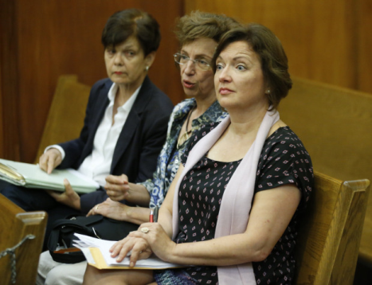
2-Public and Fair Hearings
France: JAP hearings: held in camera
PSC: always public hearings
So Who is right?
Pro: intimate, possibly more conducive of a therapeutic alliance/crime not advertised/private life/possibly more conducive of reinsertion into the community
Cons: LJ/public acceptance and education/sentencing hearings (not with JAP)/major impact on the other participants too/desistance-sobriety witnesses and supporters/ public praise

Slide 5
3-Specialisation
France: Juge des Enfants (Juvenile Judge), Juge de l’Application des Peines JAP(Reentry Court), Juge d’Instruction (Investigating Judge), etc.
Focus on the legal issue rather than on the problem
Problem-Solving Courts (PSC): Specialisation based on the issue that needs being solved (Mental Ilness Courts/Drug Courts/ Domestic Violence Courts/Reentry Courts/etc.)
Why specialise?: trained judges/experienced judges (Chicken and the Egg or both?: H-Evans, 2014)
There’s a risk of overspecialising as some issues are related (eg mental health & drugs or distinguishing between drug and alcohol addiction…)

Slide 6
4-Problem-Solving
Remember that PSC are a praetorian creation with the initial goal of solving a local
problem…
Pb-solving can mean:
1) Loose social work;
2) Risk-Needs-Responsivity (Andrews & Bonta, 2010)
& dealing with criminogenic needs
3) Core Correctional Practices (Trotter Style: Trotter, 2015)
a mix of 2 & 3 ? – see Glasgow model

Slide 7
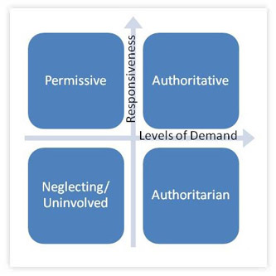
5- swift and Intermediary Sanctions + encouragement
Remember the Operant Conditioning and Social Learning models which I presented previously
Here we mean: a very swift or immediate reaction to positive changes (praise, perhap reducing the intensity of supervision…) and to negative changes (disappointment, increasing the intensity of supervision – France with Probation Orders: prolonging the order) or violations (sanctions, including short periods of time in jail…)
Best parenting: authoritative: high enough expectations (but depending on the child)/praise/shows disaprovement/constant attention, reactions and supervision (eg: Alizadehet alii, 2011). Telling a child ‘you have been bad, I’ll punish you in six months if I have the time’ is highly unlikely to work.
PSC: ‘tough love’
Also important: self-determination (theory) + autonomy support
What kind of ‘parents’ are French judges?

Slide 8
6-Collaborative & Interagency Work
Collaboration can mean a number of things:
Collaborating with the probationer/service user
This is essential. The treatment and supervision plan must be negotiated with the person (Trotter, 2015+ Self-determination theory), i.e. midway between imposing and letting the person do what he wants… (Trotter, 2015). Not an easy thing and this is where the theory of consent which I presented previously is useful.
Again, the idea is: doing things with the person rather than to the person.
Collaborating with service users’ families: Drug users /probationers are to be reintegrated into something. This means the community (see following slide) and their families. Emotional dimension to this… The Criminal Justice System cannot do everything. It cannot expect families to do everything either (= to a great extent French model) without associating them and respecting their own agency, but also their knowledge…
« of the guys desist it’s thanks to them, not thanks to us » (JAP, 11 dec. 2015)
Collaborating with other agencies and in this case can have two meanings: referral and sequential work/integrative work (I’ll get back to this tomorrow as it’s so essential, and at the same time so problematic in France, that it warrants its own presentation)

Slide 9
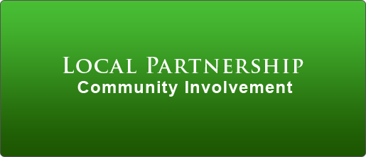
7-Community Based Justice
The first PSC was a Community Court
The idea is not only to solve a crime and drug issue, but to improve the well-being of a community and solve its problems (the damage caused by drug epidemics and the crimes committed)
The idea is also to think about the wider society at least, locally, and improve public perception of the Justice System (‘it sorts our problems out’)+ to involve the community (’our tribunal’)
And of course: PSC being based on an interagency integrated model, it can only work in a local/community embedded basis.

Slide 10
8-One Stop Shop
The problem with attrition:
People who start programmes and leave it before the end have worse results than people who do not start programmes.
Studied with RNR programmes (eg Hatcher et al., 2010) but there is no reason to think that attrition from regular probation or from a PSC programme do not cause the same negative outcomes.
Attrition increases monumentally when services are far and in different places.
consequences:
1- Allocating the right people in the programme. Drug courts are intensive programmes so based on RNR theory only high risks (but also highly addicted people) should participate -=Glasgow model
2- let’s not forget about responsivity and diversity: much more attrition with minorities: Wormith & Olver, 2002
2- One stop shop : if all the services are onsite and readily available, people don’t drift away…

Slide 11
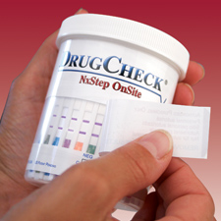
9-Frequent Drug Testing
Not habitual in France
But vital for at least 3 reasons
1- Again, Operant Conditioning. Impossible if we don’t know whether the person is currently using and what.
2- Absurd to imagine that one can adequately deal with addiction whilst not knowing what the person’s present using levels are. Would a cancer doctor be able to care for a cancer patient without knowing whether he’s stage 1, 4… and whether he still smokes and get s drunk?
3- Important to teach honesty , accountability, and disclosure to people who have put their head in denial sand for years… (also: restructuring theory… and pro-social modelling)
Does not mean we should send the person back to jail just because he’s using. Means a reaction should ensue, in terms of treatment, control and sometimes sanction.
Whether we should aspire to sobriety (abstinence) or maintenance is another issue – and partly cultural … I like Glasgow’s straightforward answer to this: it depends on the person…

Slide 12
10-Desistance Rituals
We have seen the importance of rituals in my first theoretical presentation
US DTC and other PSC always have desistance rituals, which they call ‘graduation ceremony’
New Zealand courts allow Haka dances to take place!
Glasgow: ‘we don’t do that kind of thing’
(Nolan, 2009: cultural embarrassment in some jurisdictions)
France? Invent our own desistance ritual? Any ideas?

Slide 13
And Only Non-Violent Offenders?
Initially with the community courts as this was a pioneer approach with the risk of being seen as being soft on crime.
Necessary in the context of US public opinion
However there are US exceptions and notably: DV courts and reentry courts
Glasgow DTC deals with violent offenders
France: JAP deal with violent offenders (including high risk sex and violent offenders)

Slide 14
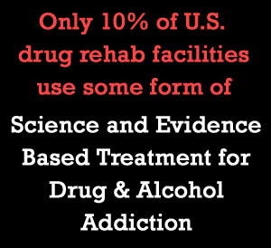
But Also…
EBP Treatment
Do we really do what works: AA/NA + therapeutic communities+cognitive behavioural treatment /substitution , etc. and do we adapt this to the individual (gender issue for instance with the utmost important of trauma theory for women…)
(Eg Miller, 2009)
EBP Supervision
Not all DTC or PSC are based on sufficient supervision evidence be it RNR (Andrews & Bonta, 2010) or CCP (Trotter, 2015)
=> with treatment the pb is : what is out there?
Flexibility
Holistic, yet structures approach
EB Outcome Evaluation
Comprising eval: reoffending of course/but also Seriousness of new offence+survival rate+attrition rates+compliance with obligatins+addiction+social improvements or pbs solved+ physical condition…and how much money all this saves.
France’s problem with solid eval. (criminology faculties!) (more later with Jean-Pierre Guay…)

Slide 15
References
Alizadeh, S., Abu Talib, M. B., Abdullah, R., & Mansor, M. (2011). Relationship between Parenting Style and Children's Behavior Problems. Asian Social Science, 7(12), 195-200.
Andrews D. et Bonta J. (2010), Psychology of the criminal conduct, LexisNexis (en français Presses de l’ENAP, 2015)
Bureau of Justice Assistance (1997), Defining the Drug Courts. The Key Components
Hatcher R.. M., McGuire J., Bilby C.A.L., Palmer E. J., Hollin C. R., (2012) « Methodological Considerations in the Evaluation of Offender Intervention: the Problem of Attrition », International Journal of Offender Therapy and Comparative Criminology, n° 56(3): 447-464.
H-Evans M. (2013 ), Le juge de l’application des peines: Monsieur Jourdain de la désistance, l’Harmattan (French reentry courts and rehabilitation: Mister Jourdain of desistance, L’harmattan, 2014)
H-Evans M. (2014), ‘La perception de l’expertise par les JAP: une recherche empirique’, Ajpénal: 516-520
H-Evans M. (2015) (ed.), Offender release and supervision: The role of Court and the use of discretion, Nijmegen, Wolf Legal Publishers.
Miller P.M. (2009) (ed.), Evidence-Based Addiction Treatment, Elsevier & Academic Press
Nolan J.L. (2009), Legal accents. Legal borrowing. The international problem-solving court movement, Princeton University Press,
Trotter C. (2015). Working with Involuntary Clients. A Guide to Practice, Routledge, 3rd ed.
J. Stephen Wormith et Mark E. Olver (2002). Offender Treatment Attrition and its Relationship with Risk, Responsivity, and Recidivism, Criminal Justice and Behavior, n° 20(4) : 447-471

Slide 16
Merci! Thank you!
http://herzog-evans.com
martineevans@ymail.com
martineeevans@gmail.com
@ProfMEvans

