Slide 1
How Drug Courts do it? Collaboration, Collaboration, Collaboration!
Prof. M. H-Evans
Rheims University

Slide 2
Collaborative-Therapeutic law
Collaborative law: alternative non adversarial dispute resolution, originally in family and divorce cases
Therapeutic jurisprudence (has already been presented by David Wexler): well-being rather than fight. People must decide what is good for them.
= One aspect of collaboration, between parties.
Gold standard: Drug Courts and other PSC: integrated collaboration, onsite, information sharing + Pre-hearing meetings.
Reminder: collaboration is an essential component.

Slide 3
Different Meanings
The Criminal Justice System (CJS) collaborates with the justiciable in order to find the right plan/path/measure with him.
The CJS collaborates with families and/or the justiciable’s environment/community in order to better support him/her towards recovery/desistance.
The CJS collaborates with other agencies and staff.
We shall focus on this one.

Slide 4
Different Shapes and Forms
Interagency collaboration can be done in different ways:
Referral or brokerage parallel systems. As in France with JAP&probation services (PS): people are mandated to get treatment, the JAP informs the PS, who informs the justiciable, who is given addresses and must give documented proof of attendance. => lots of attrition + information is not shared (risk – see Cluley, 2010 and the French Pornic or 1st Chloé case)+ contradictory decision-making
Partially integrated systems. Service users are referred to outside services, but there is some level of information exchange between the different agencies and they may meet and work together on the different cases (in France: JAP with probation services). => lots of attrition + information is not sufficiently shared (risk)+ contradictory decision-making
Fully integrated onsite systems (Drug Courts and other PSC). All the agencies and personnel work onsite on the cases. They exchange information and make some decisions collaboratively. The judge is one of the actors of the team and does not make decisions on his/her own. => much less attrition or risk+ better decision-making (better decisions)

Slide 5
Why Collaborate?
More information shared = less risk+ decisions are better tailored
Different professional cultures = better informed decisions (e.g. police officers less harsh/social workers less gullible).
Better to solve complex issues with different (and at times contradictory) aspects
Cheaper: pooling means, efforts, and knowledge
More coherent for offenders (less contradictory messages)
See all references used here at the end of this powerpoint

Slide 6
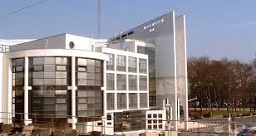
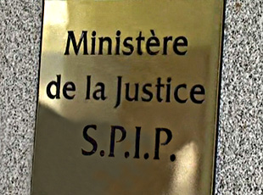
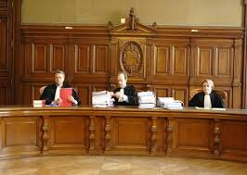
Who ?
Judge
Probation officers or social workers
Associations (third sector)
Addiction specialists
Mental health specialists
Police officers
Etc.
Prosecutors? (US)
Attorneys?

Slide 7
How?
One stop shop/onsite services as much as possible
= Conducive of a common culture (France’s opposite example…)
A charismatic, enthusiastic, leader
(not a manager)= the coordinator
Enough funding and not one party which has much more than the other(s)
A common desire to focus on the goal rather than on one’s supposed turf

Slide 8
Obstacles and their solution
One agency is much more powerful than the other= it tends to see the others as its employees or subcontractors… =>local programmes
One agency has all the money and controls the other ones
=>detachment and common budget
Not enough funding in general => diversify &
go local!
Professional cultures are vastly different (offender/client/patient…). => be patient, open minded, have a good leader. After a while though, common acculturation (Glasgow: police officer and SW in jeans!) and learn to get along, if their intentions are good.

Slide 9
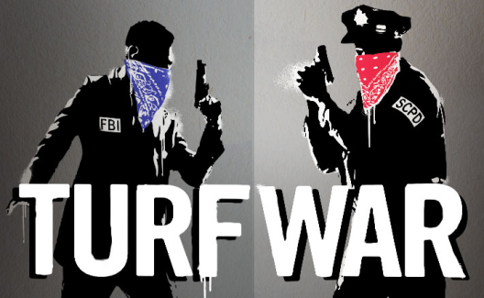
Obstacles and their Solution
One (or more) agency is highly corporatist and has no collaborative culture, does not want to collaborate, considers that offenders are his, and partners are incompetent, etc… or worse, their headquarters add fuel to their non-collaborative attitude.
Recognise anything here?
Solutions
reduce the size of these agencies to limit their
corporatism
- go local rather than national
detach practitioners (see above) from their agencies so that they’re (partly) cut off from their institutions
Go Tony Blair (1997) and declare an general collaborative duty (inter-ministerial secretary of state?)
Assign clear common goals

Slide 10
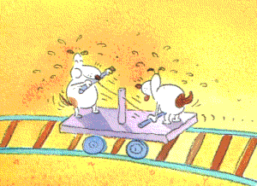
And…
Joint Training Sessions
Already happens with the National Judge Academy (ENM)!
Internship with other partners
Already happens with ENM!
Recruitment more focused on skills and personal qualities
Than on academic knowledge : we need good people who are
Willing and able to collaborate
Continue to fight for more money, more means, more staff, and focus on what really counts… McJustice feeds on the lethal nexus of the CJS financial plight and nonsensical managerial targets
Other ideas? Let’s collaboratively find solutions!

Slide 11
References
Cluley, A. (2010) Serious Further Offence, The case of Dano Sonnex, Probation Journal, n° 57(1) : 83-88.
Sloper P. (2004), Facilitators and barriers for co-ordinated multi-agency services, Child Care, Health and Development, n° 30(6) : 571-580
Pycroft A. & Gough D. (2010) (eds.), Multi-Agency working in criminal justice, Control and care in contemporary correctional practice, Bristol, The Policy Press
Rumgay J. (2003), ‘Partnership in the probation service’, in W. Hong Chui & M. Nellis (eds.), Moving Probation Forward, Evidence, Arguments and Practice, Harlow, Pearson Longman: 195-213.
Sullivan H. & Skelcher C. (2002), Working Across Boundaries, Collaboration in Public Services, Basingtoke, Palgrave Macmillan

Slide 12
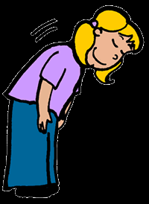
Merci! Thank you!
http://herzog-evans.com
martineevans@ymail.com
martineeevans@gmail.com
@ProfMEvans

