Slide 1

Who supports desistance in France?
M. H-Evans
Reims University, Law Faculty

Slide 2


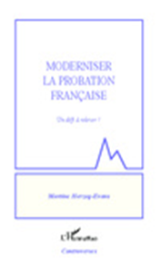
Studies on Who works & desistance
Who works in French probation & release with theoretical lenses : 1) desistance;
2) legitimacy of justice; 3)
Therapeutic jurisprudence
But also drawing on CCP; What Works…
Series of studies:
1) Probation Officers (2009-2011) (MHE, 2011 a
2) Juges de l’application des peines (reentry &
release judges) (2010-2013)
3) Third sector (2012-2013)
4) Ongoing: attorneys

Slide 3
Martine’s published research on Who Works
1) Probation
(2011 ), ‘Probation in France: Some things old, some things new, some things borrowed, and often blue’, Probation Journal, n° 58(4): 345-354
(2011 ), ‘Desisting in France: What probation officers know and do. A first approach’, European Journal of Probation, vol. 3(2), pp. 29-46
(2012), The six month limit to community measures ‘under prison registry’: a study of professional perception »European Journal of Probation, vol. 4, n° 2, pp. 23-45.
(2013), ‘Explaining French probation: social work in a prison administration’, in Durnescu I. & McNeill F; (eds.), Understanding Penal Practice; Routledge: 63-76.
(2013), Moderniser la probation française: un défi à relever, Paris, l’Harmattan.
2) J.A.P.
(2012), ‘Non-compliance in France: a human approach and a hair splitting legal system’, European journal of Probation, n° 4(1): 45-61
(2013), « Offender Recall for Non-Compliance in France and Fairness: An Analysis of ‘Sentences Implementation Courts’ Practices’, in P. Ugwudike and P. Raynor (eds.), What Works in Offender Compliance. International Perspectives and Evidence-Based Practice, Palgrave MacMillan,: 185-207
(2014), French reentry courts and rehabilitation: Mister Jourdain of desistance, Paris, l’Harmattan.
J.A.P. and risk assessment experts.
(forthcoming) ‘ What the jeck can this possibly mean?’ French reentry courts and experts’ risk assessment’ (in French inAjpénal, June)
3) Third sector
(2014 ), ‘French Third Sector Participation in Probation and Reentry: complementary or competitor?’, European Journal of Probation, n° 6(1): 42-56.
4) Attorneys
(2014), ‘La défense et la dimension collaborative de l’application des peines’, in S. Slama et N. Ferran (eds.), Défendre en justice la cause des personnes détenues, Paris, La Documentation Française,: 81-99
Forthcoming: Offender release and supervision: The role of Courts and the use of discretion, Nijmegen, Wolf Legal Publishers.

Slide 4
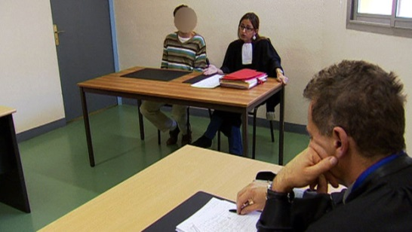

General overview (historical)
.
1885: Conditional release (no supervision/charity reentry
support)
1945: Experimentation of JAP
1949. Creation of state probation
1958: JAP go to scale + suspended custody with
probation (SME)
1993: New PO name (probation an insertion councillors - CIP)
and recruitment (lawyers)
1999: Prison and community probation merge: both taken over by
Prison services
2000-2004. Bipartisan reforms: fair trial in release and recall
2002-2012: More than 12 punitive reforms in criminal law, release &
Supervision (hugely complex + overcrowding made even worse)
2008. PO are supposed to be criminologists/Canada Dry of
      Criminology +Economic crisis + prison services disciplinary governance
2010. decree deletes all mention of social worker for PO in PPC +New PO
Name: Penitentiary name(Penitentiary probation and insertion councillors: CPIP)
Currently: a new bill wants to return to the release system prior to 2000 without fair trial
.

Slide 5
Who does what … on paper
1) J.A.P. make important decisions
Transformation (‘conversion’) of imprisonment (up to 2 years) into CSM if no bench warrant;
Release (conditional release, medical sentence suspension, EM, semi-freedom, placement in the community)
remission; furlough; humanitarian furlough under escort;
sanction of breach for CSM (all sorts of sanctions…)
criminal record expunging
In charge of the supervision process but do not see probationers
regularly
Fair trial applies to: a, b, d, e
Non-formal hearings either at court (JAP’s office) or in prison
Appeal/Court of cassation

Slide 6
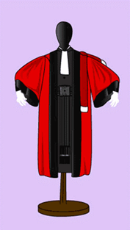
Who does what … on paper
2) Prosecutors:
can take offenders to court (breach);
give their opinion in court;
- responsible for the exact length of
sentences.

Slide 7

Who does what … on paper
3) Probation services
Are part of the prison services (work in prison & in the community: same hierarchy)
Daily supervision (officially 90/100 cases/PO – real life: 130-140 – in Reims: 180; in Châlons:200)
Investigations (pre-release; pre- ‘conversion’)
Report incidents to the JAP
Supposedly prepare
prisoners to release

Slide 8
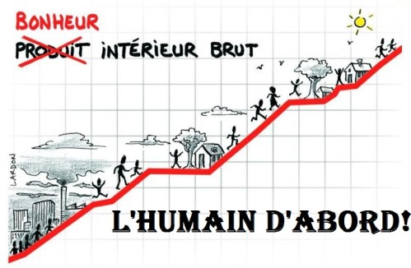
Who does what … on paper
4) The police (or gendarmes)
May do investigations for the JAP (when tricky or… on site)
Arrest probationers in breach/ flight
Execute JAP’s warrants
5) Third sector
In charge of reentry (real reentry)
Supervise offenders in certain cases
Provide community work
Provide housing, food, etc. (real social work)
Provide placements in the community
Shelters
Drug Treatment
Programmes (e.g. in Reims domestic
violence)
+ Work with victims
+ Work with families
            Gross domestic happiness/ Humans first!

Slide 9


Who does what … on paper
6) Medical sector
Psychiatrists
- treatment (referred offenders)
- experts’ reports (they do risk assessment for high risk offenders/never probation services
Drug treatment
Mainstream medical sector
7) Attorneys
- present release applications
- defend offenders in recall cases

Slide 10

In real life
Probation services
A lot of PO think of themselves in terms of ‘interface with the JAP’
- mostly prepare release measures: part of prison services: instrumentalised to solve the prison overcrowding issue. They do not prepare prisoners for reentry (support…); they only prepare (and in some cases) the legal framework around it /de facto they’re sort of legal clerks
- huge identity issue. Went from social work to legal clerks (60% of lawyers recruited each year) and not quite yet criminologists (2008=>) (Dindo, 2011; Larminat, 2012; H-Evans, 2011 a) & very diverse practices & competence
- strong resistance to evidence-based practices (spe. Risk& Needs assessment)… but signs of progress
=> very little real supervision going on (extremely loose & unsupportive)
=> often useless and very short reports focusing on what the offender should do rather than on what should be done
=> no time to build a relationship
=> ‘not my job to help’ (H-Evans, 2011b; 2012)
=> think in terms of turf (particularly their lawyer-managers re JAP) and huge problems of turf with JAP since they de facto see themselves as legal clerks
=> being in the prison services: prison culture and thinking: in partnerships see themselves as in charge
=>No evaluation of their work: we don’t know if it works - but comparing to what works (general meaning) currently unlikely
NO DESISTANCE WORK IN MOST CASES

Slide 11
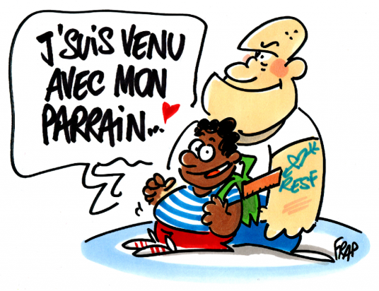
In real life
Third sector (: ‘associations’) I came with my mentor
De facto does all the social, psychological and supportive work that probation services don’t want to do or are not allowed to do by their administration (social worker deleted from PPC/recidivism prevention as the unique task…)
Better local embedding
Flexible and can be very innovative
Employ those who are disappearing from prob. Services: psychologists & social workers
Do the real work (e.g. for addicts)
Since there is no turf issue with them: they come out as less annoying for many JAP and prosecutors, or local authorities
Have no pb being collaborative with the judiciary, the local community and networks and with other associations
More holistic & relationship based
(but issues of competence)
THEY ARE THE ONLY ONES WHO ARE TRULY IN CHARGE OF DESISTANCE (H-Evans, 2014 a)

Slide 12
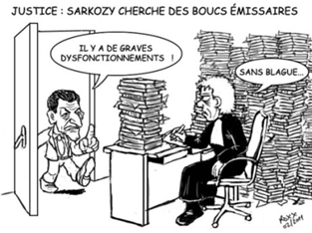
In real life
J.A.P.
                Justice : Sarkozy is looking for scapegoats.
                ’There’s huge malfunctions!’
                ‘No kidding!’
Nationally. Under constant attack by the executive (prison services) who would like to make release decision in their stead or return to pre 2000-2004 (3 laws in a raw in that vein: 2004; 2009 (both failed) now 2014?)
Prison services want to eliminate or marginalise due process in supervision and thus create an automatic release system where people are processed out of prison without bothering to prepare a credible release plan and ensuring they’ll be really supported in the community (: managerial hospital beds logic)
Locally: turf issues with probation services managers who see themselves too often as powerful managers/authorities – rather than as probation leaders.
They have a strong desistance culture (H-Evans, 2014 b), but are also overloaded and instrumentalised (‘camembert’ managerial pressure) and pressurised (threats and bullying from prison services: ‘protocols or else’ in big jurisdictions) and do not see offenders regularly enough.
= strong SYMBOLIC DESISTANCE SUPPORT (fair trial/ respect/care…)

Slide 13
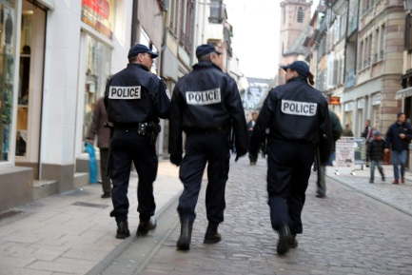
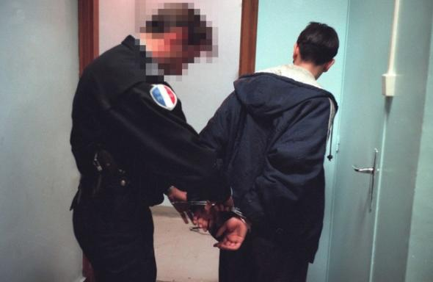
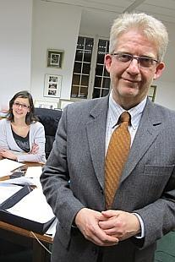
In real life
The police
Never associated to programmes or actions with the probation services.
Probation services are thus blind as to what the police does (and vice versa) Can be different with third sector in collaborative programmes e.g. with domestic violence…
= Could do much more.
Prosecutors
Some extremely innovative. Real power in their juridiction
Used to work collaboratively
e.g. ‘reenforced probation’ ( now ‘reenforced support’) in Cambrai,
Beauvais and now Saint-Quentin
e.g. domestic violence programme in Reims
= Can be a huge driving force in collaborative desistance
programmes
Jean-Philippe Vicentini, Prosecutor in Beauvais, formerly in Cambrai,
Also visiting professor in our faculty

Slide 14



In real life
General practitioners (MD)
Often in charge of addicts and mentally ill : other services overloaded
Probably not very competent, but probably develop therapeutic alliance
Psychiatrists
Inmost cases old school clinical assessment….
Old school Freudian treatment (Baratta
& Halleguen, 2012)
Little hope that they get results
Attorneys (H-Evans & students, ongoing)
Most are classic attorneys (see above)
Some are holistic attorneys: help prepare release plans… build a relationship with offenders and their families… are proactive and follow the person throughout his sentence.
=> Holistic lawyers probably participate in the desistance process (the others useful in terms of legitimacy of justice)
= ongoing research…
Two holistic lawyers (Boesel & Bianchi, Paris Bar)

Slide 15


Real problems
Non collaborative work/turf issues
Sequential or parallel work
Tensions with managers
Tensions with goals
Tensions with the issue of documented proofs
Tensions with JAP’s decisions deemed too lenient
Tension with JAP deemed too careful with cases, people and files
Probation services think they are the monopolistic gendarmes of the whole process (e.g. vertical collaboration (sic) with third sector)
=> ‘probation/desistance/reentry is nobody’s property’ – it should be a joint effort (French Probation Confederation: http://lacfp.net/)

Slide 16
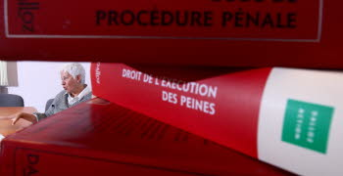
French dream: law changes reality
In France social issues are ‘changed’ by new laws
Real issues not addressed
Current MoJ believes a new community
Sentence (contrainte pénale: penal constraint)
will miraculously make sentencing courts not pronounce custodial sentences
will miraculously be more credible than the current probation I described
=> predictable failure

Slide 17
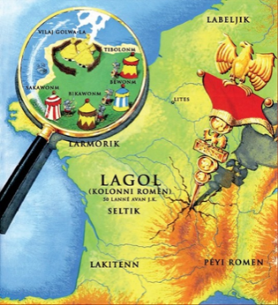
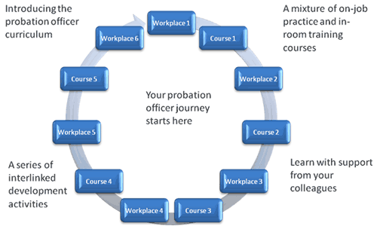

French perception: measures rather than programmes
In France: belief that legal framework for measures (sentences or release measures) solve all issues
No idea what a programme means
No idea that real issues are professional practices, skills, etc.

Slide 18
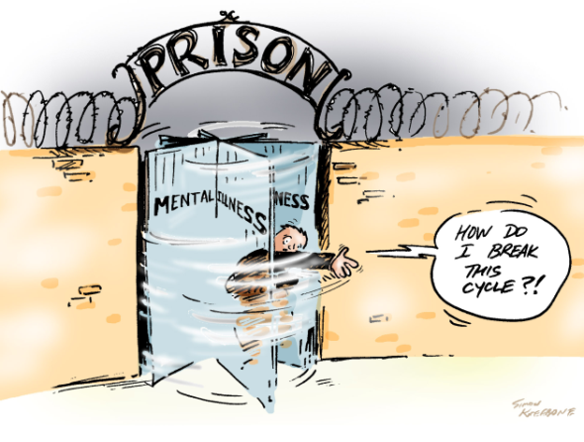
French perception: release at all cost
Simplistic idea: early release is virtuous per se and therefore we should early release everyone even without a plan, housing, money and health coverage
-No understanding of the pains of probation (Durnescu, 2010) and the risk of mass supervision (Phelbs, 2013), nor that a lot of offenders prefer prison to some harsh
Probation measures (May
& Wood, 2010) in particular those
with personality disorders
(Ramsden & Lowton, 2014)

Slide 19
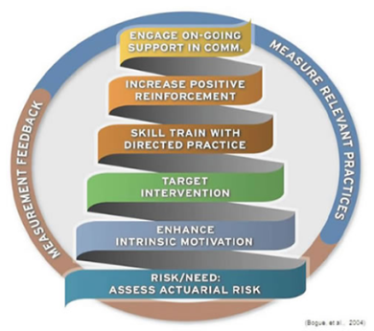




The future of French probation
Currently debated Bill
new community sentence with more constraints (slightly) but no change in supervision and support
But not new: police will be able to detain people serving a CSM
( but no collaboration)
virtually automatic early release for all offenders sentenced to up to 5 years. JAP marginalised + fair trial non-existent (and ‘to hell with’ Tyler, 2006; 2007; Ugwudike et Raynor, 2013, Crawford et Hucklesby, 2012 findings).
French PO learning about evidence-based practices and some psychologists & social workers coming back… cross fingers.
General reform of the judiciary: will eliminate specialisation and perhaps JAP
Hopefully third sector will continue its professionalisation

Slide 20



Conclusion
What we need: Radical reforms:
(cut the institutional ties between prison & probation;
Change recruitment (people with skills rather than
x or y diploma/social workers & psychologists rather than lawyers, even if Durnescu, 2013 is optimistic) ; change training)
- Science in probation and evaluation
We need to know what works and what doesn’t ;
We need to have a blue print of French practices;
We need to be more modest (sigh) and ask for help
- Collaborative work
This is the essential Tony Blair like mantra that
We need to adopt
And how about real problem-solving courts…
(current pretend Drug Court in Bobigny)

Slide 21

A few ref.
Crawford A. & Hucklesby A. (2012), Legitimacy and compliance in criminal justice, Routledge
Dindo S. (2011), Sursis avec mise à l’épreuve : la peine méconnue. Une analyse des pratiques de probation en France, Etude pour la Direction de l’administration pénitentiaire, bureau PMJ1, May
Durnescu I. (2011), ‘Pains of probation: Effective practice and human rights’, International Journal of Offender Therayy and Comparative Criminology, n° 55(4): 530-545.
Dunescu I. (2013), ‘’Probation skills between education and professional socialization’, European Journal of Criminology, online first: doi: 10.1177/1477370813504162
Halleguen O. & Baratta A. (2012), ‘L’injonction de soins. A propos d’une étude réalisée sur les régions Alsace et Lorraine’, L’Encéphale, n° 40(1): 42-47.
Larminat X. (2012), La probation en quête d’approbation. L’exécution des peines en milieu ouvert entre gestion des risques et gestion des flux, Thesis Cesdip-Université de Versailles-Saint Quentin
May D.C. & Wood P. B. (2010), Ranking Correctional Punishments. Views from Offenders, Practitioners, and the Public, Carolina Academic Press
Phelps M. S., (2013), ‘The paradox of probation; Community supervision in the age of mass incarceration’, Law & Policy, n° 35(1-2): 51-80.
Ramsden J; & Lowton M. (2014), ‘Probation practice with personality disordered offenders: The importance of avoiding errors of logic’, Probation Journal, online first: doi: 10.1177/0264550514523815 .
Tyler T.R. (2006) Why People Obey the Law, New Haven, CT, Yale University Press, 2e éd.
Tyler T.R. (2007) Legitimacy and Criminal Justice. International Pespectives, Russel, Sage Foundation, New York
Tyler T. (2013), ‘Legitimacy and compliance: the virtues of self-regulation’, in A. Crawford and A. Hucklesby, Legitimacy and compliance in criminal justice, Routledge: 8-28
Ugwudike & Raynor (eds.) (2013), What Works in Offender Compliance. International Perspectives and Evidence-Based Practice, Palgrave Macmillan

Slide 22

Merci! Thank you!
http://herzog-evans.com
martineevans@ymail.com
@ProfMEvans

